Slide 1
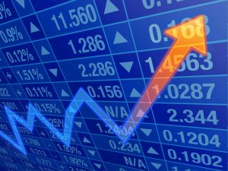
Stock price prediction using ML
https://github.com/akj-new-era/Stock-Price-Prediction

Slide 2
Abstract
To examine a number of different forecasting techniques to predict future stock returns based on past returns. We do this by applying supervised learning methods for stock price forecasting by interpreting market data. We are primarily looking to apply linear models and later on moving to neural networks.

Slide 3
Introduction
Stock (also known as equity) is a security that represents the ownership of a fraction of a corporation. This entitles the owner of the stock to a proportion of the corporation's assets and profits equal to how much stock they own. Units of stock are called "shares."A stock is a general term used to describe the ownership certificates of any company.
Stock prices change everyday by market forces. By this we mean that share prices change because of supply and demand. If more people want to buy a stock (demand) than sell it (supply), then the price moves up. Conversely, if more people wanted to sell a stock than buy it, there would be greater supply than demand, and the price would fall.

Slide 4
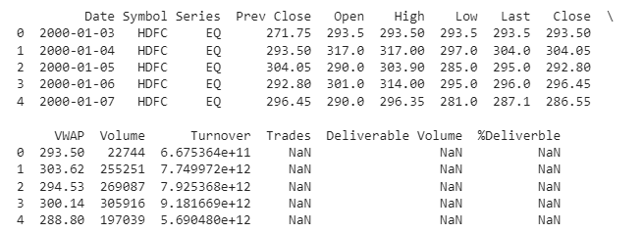
Data set
To train and test our model we used data from HDFC, ITC and INFY from the year 2000 to 2021 which is taken from kaggle(https://www.kaggle.com/datasets/rohanrao/nifty50-stock-market-data). This dataset contains daily stock prices at which this open and close, daily high and low values, company's volume and turnover,previous day stock price,etc.

Slide 5
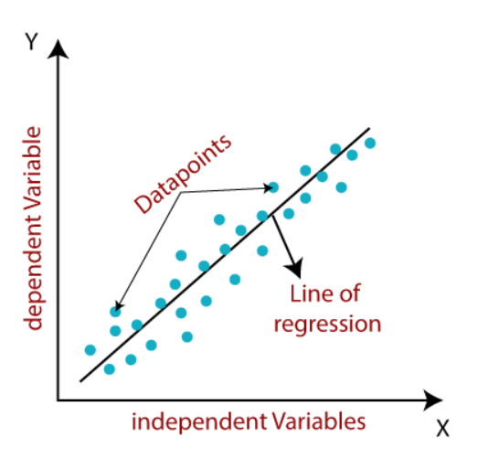
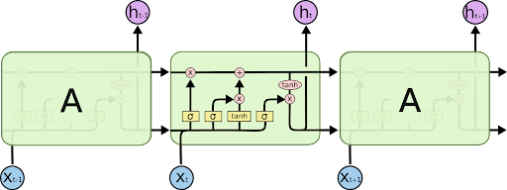
Methods used
Linear regression RNN using LSTM model

Slide 6

Linear Regression
Linear regression algorithm shows a linear relationship between a dependent (y) and one or more independent (xi) variables and shows how the value of the dependent variable is changing according to the value of the independent variables.
In this method we find the best fit line as follows.
1) Define a linear model
y= a₀+a₁x+ ε
2) Define a Cost function
Here we will be using MSE cost function

Slide 7

Linear Regression
3) Use Matrix method for minimizing the error between predicted values and actual values
A = (X^{T}X)⁻¹X^{T}Y
This equation will give us the optimized value of the Coefficient Matrix (A)
4) Checking the Performance using R Squared/ coefficient of determination
The high value of R-square determines the less difference between the predicted values and actual values and hence represents a good model

Slide 8
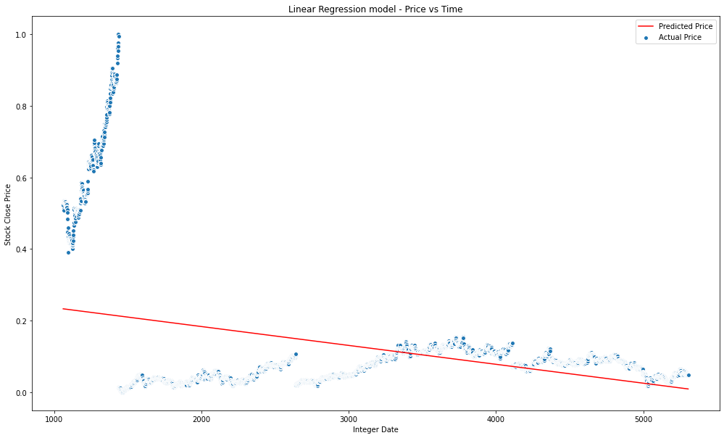
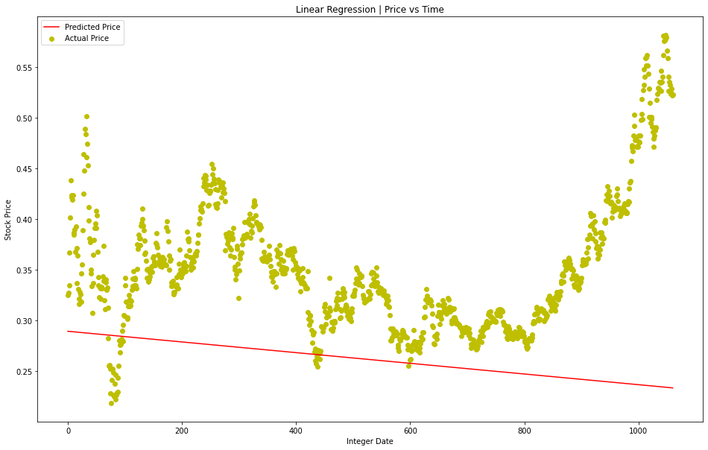
Results using Linear Regression
ITC: Train data Test data

Slide 9
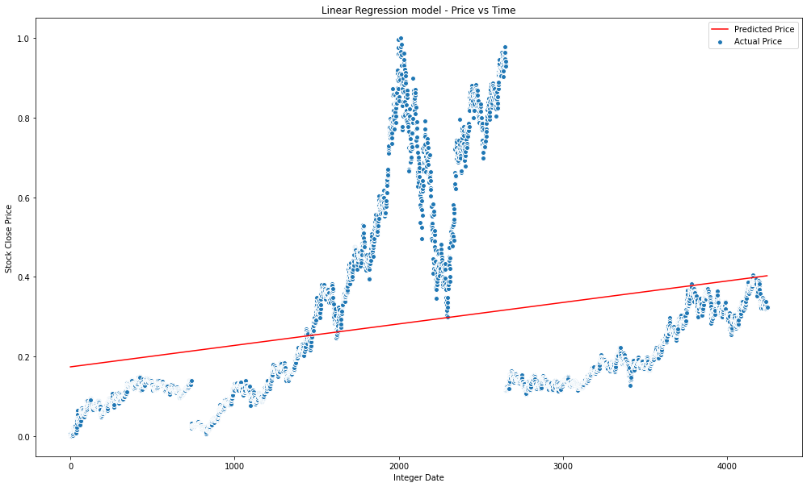
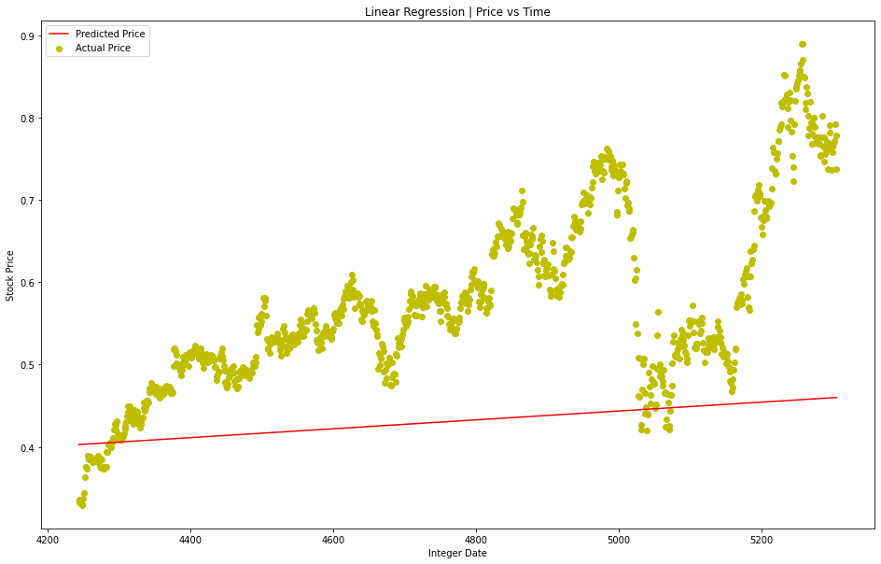
Results using Linear Regression
HDFC: Train data Test data

Slide 10
Need for a better model
Stock markets in the real world are influenced by sentiments of humans, hence they are nowhere close to linearity.Use of linear regression cannot model stock markets.They give huge errors in predicting prices.To model stock markets we need models that can capture non-linaearty.So we move on to Recurrent Neural Network(LSTM).

Slide 11
RNN
It is a class of neural networks tailored to deal with temporal data. The neurons of RNN have a cell state/memory, and input is processed according to this internal state, which is achieved with the help of loops with in the neural network. There are recurring module(s) of ‘tanh’ layers in RNNs that allow them to retain information. However, not for a long time, which is why we need LSTM models.

Slide 12
LSTM
Recurrent neural networks (RNN) have proved one of the most powerful models for processing sequential data. Long Short-Term memory is one of the most successful RNNs architectures. LSTM introduces the memory cell, a unit of computation that replaces traditional artificial neurons in the hidden layer of the network. With these memory cells, networks are able to effectively associate memories and input remotely in time, hence suited to grasp the structure of data dynamically over time with high prediction capacity.

Slide 13

LSTM
LSTMs have a chain-like structure, but the repeating module has a different structure. Instead of having a single neural network layer, there are four, interacting in a very special way

Slide 14
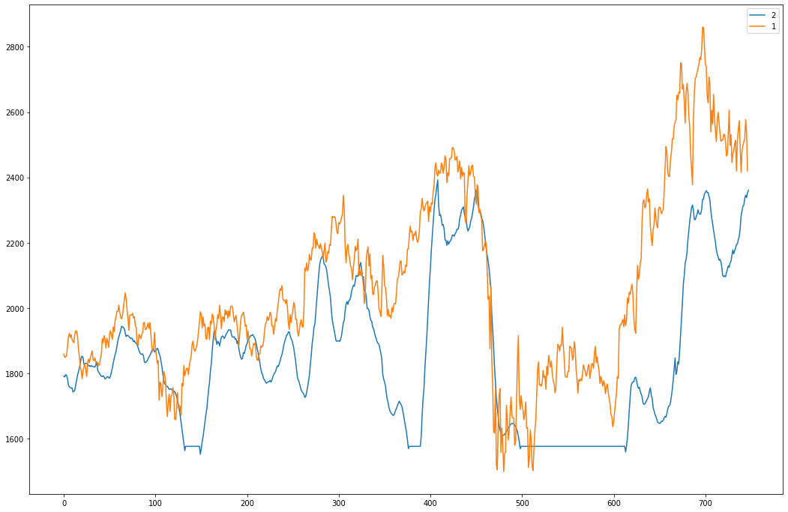
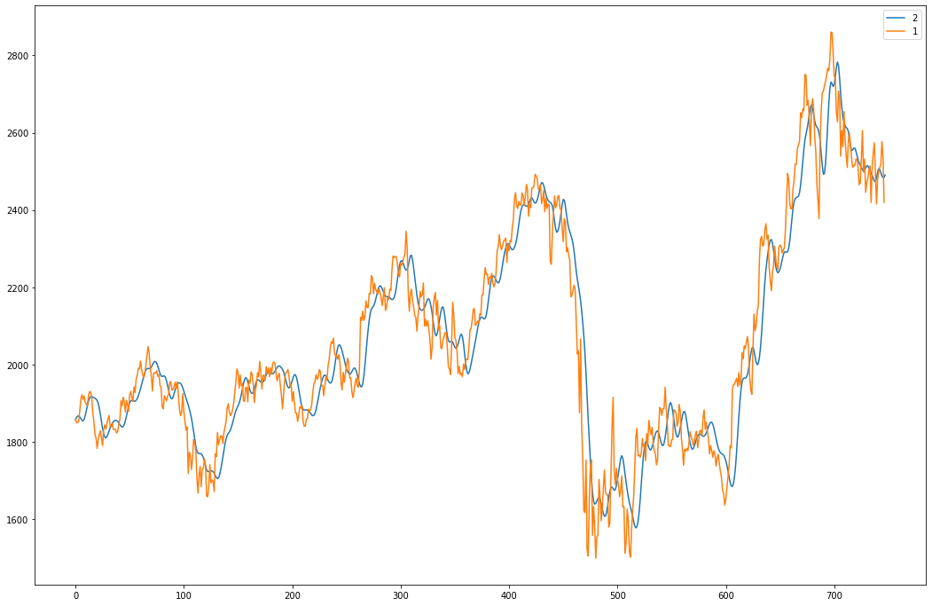
Importance of feature selection
Price+Volume 7 Day Moving Average+ Volume
(HDFC)

Slide 15
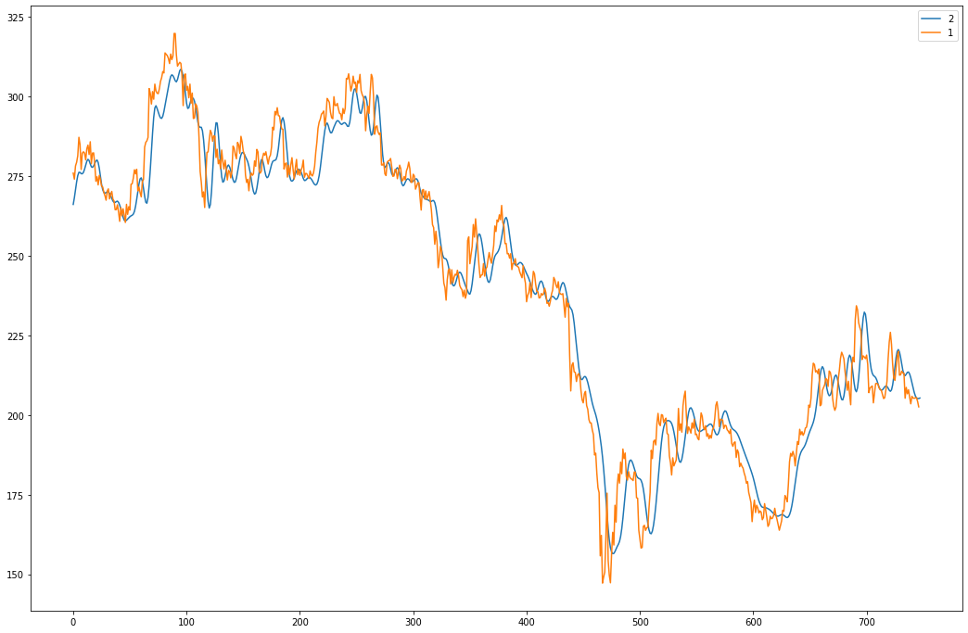
Results using LSTM
ITC: Test data

Slide 16
Results using LSTM
HDFC: Test data

Slide 17
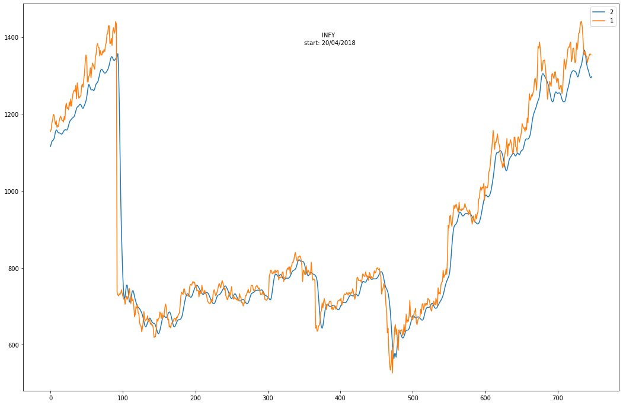
Results using LSTM
INFY: Test data

Slide 18
Analysis
Errors obtained using Linear Regression
Errors obtained using LSTM
Companies | HDFC | ITC | INFOSYS
Mean Squared Error | 245146.57934 | 53423.3812 | 159334.2670
Mean Absolute Error | 416.1567 | 228.669 | 280.6234
Coefficient of Determination | -1.5125 | -29.9926 | -2.1797
Companies | HDFC | ITC | INFOSYS
Mean Squared Error | 5933.854308397654 | 61.66858715680009 | 3004.878401029405
Mean Absolute Error | 56.56770254532921 | 5.757666215539615 | 28.037047148515832
Coefficient of Determination | 0.9259315325191522 | 0.9683613473676155 | 0.9542569842578266

Slide 19
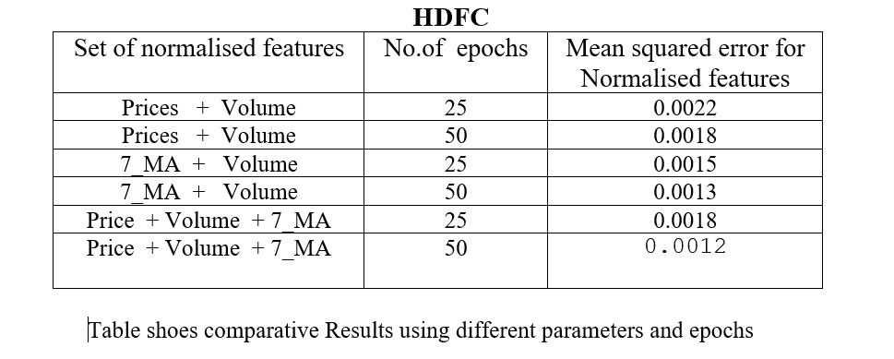
Analysis

Slide 20
Analysis
For analyzing the efficiency of the system we have used the Mean Square Error(MSE), Mean absolute error and Coefficient of determination
We observe that the error for LSTM is significantly less than that for linear regression. It provides a much better fit as it accounts for past data to predict future values.

Slide 21
Conclusion
The popularity of stock market trading is continuously increasing, prompting experts to develop new methods for predicting the future utilizing new techniques. The forecasting technique benefits not only scholars, but also investors and anyone involved in the stock market. A forecasting model with high accuracy is required to assist in the prediction of stock indexes. We used one of the most precise forecasting technologies in this work, which uses a Recurrent Neural Network and a Long Short-Term Memory unit for predicting the stock market's future situation. We can also conclude that by taking different combinations of given variables as parameters for the model, we can acquire higher accuries, which makes us aware of the fact that "More data with better models produces outstanding results".

Slide 22
Contribution
Pre-processing data: Parth, Mehul, Akshat
Linear Regression: Jay, Akshat
LSTM model: Gourikant. Jay
Theory: Parth, Mehul
Graphs plotting: Akshat, Gourikant, Jay
Slides: Parth
Report: Group contribution

Slide 23
Sources of code used
Most code is written by ourselves, with some inspiration from youtube videos like:
https://www.youtube.com/watch?v=lncoLfue_Y4&feature=youtu.be
https://www.youtube.com/watch?v=AXBhrLongC8

